Slide 1
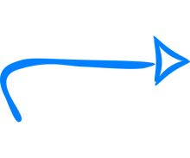
7
39
15
36
24
20
18
30
12
Step 1: Identify the pivot (e.g. mid value)
7
39
15
36
24
20
18
30
12
Step 2: Initialise your left and right pointers
7
39
15
36
24
20
18
30
12
Step 3: Slide your pointers until you find two values to swap: (e.g. 39 > pivot and 12 < pivot)
7
12
15
36
24
20
18
30
39
Step 4: Swap the two values
7
12
15
36
24
20
18
30
39
Step 5: Repeat steps 3 & 4 until your left and right pointers are both pointing towards the pivot
7
12
15
18
24
20
36
30
39
7
12
15
18
20
24
36
30
39
At this stage, the pivot is now in its final position. All values on the left of the pivot are lower than the pivot, all values on the right are greater than the pivot.
We can now repeat all the above steps (1 to 5) recursively with both sub-lists (on the left and on the right of the pivot.
…1st Recursion…
…2nd Recursion…
…3rd Recursion…
7
12
15
18
20
24
36
30
29
7
12
18
15
20
24
29
30
36
7
12
15
18
20
24
29
30
36
12
12
15
18
20
24
29
30
36

