Slide 1


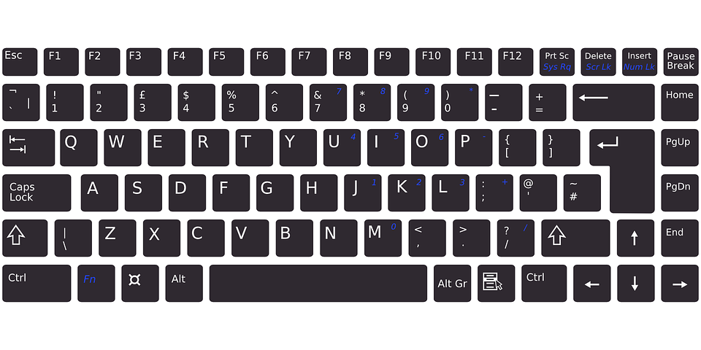
1
0
1
1
1
0
🕔
10110101101
Print(“error)
kg
cm
GHz
°C
MB
011101101
111011010
110110100

Slide 2





&
# # # #
# # # #
# # # #
# # # #
COLOUR
print(“Hello World”)
?
E R R O R
while
01101101001011011010

Slide 3




CODE
…
Select *
from table
Level 2
Level 1
2
Chr(67)
Chr(80)
Chr(85)
username
password
3
1

Slide 4







01101101001011011010110010101010101001000110101010110101010101001111100101010110100101101010101001011001101010011010101000101010100101110101010011001101010101001011010101010101010101010101010
101
data
Task Task Task Task
Task Task Task Task
Task Task Task Task Task Task Task Task Task Task Task Task
#D}@wu2-34

Slide 5






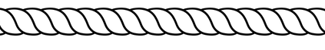
OLOGY
“text”
TOPOLOGY

Slide 6




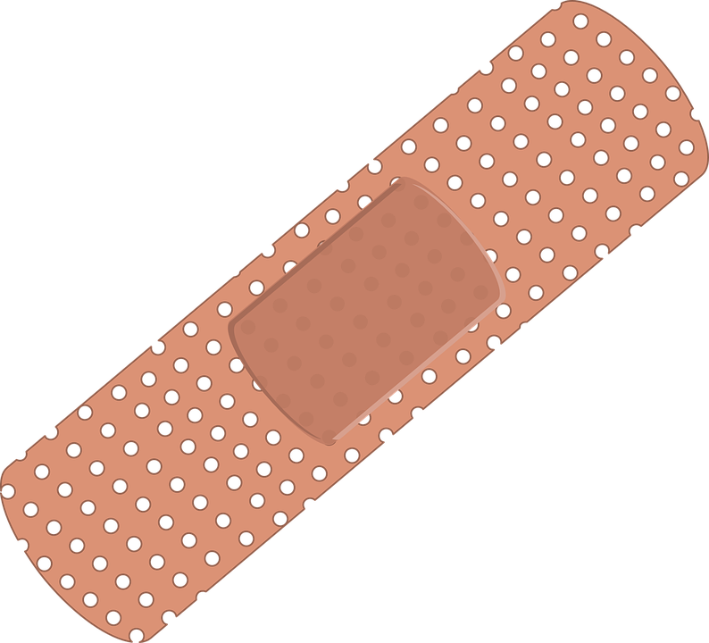
WWW
Width x Length
Width x Length
01
02
03
04
05
06
07
08
Pass123
PASSWORD
Password123
Pass1234
abcdefg
12345678
Qwerty
password


Slide 7

Pass123
PASSWORD
Password123
Pass1234
abcdefg
12345678
Qwerty
password
Search


Slide 8
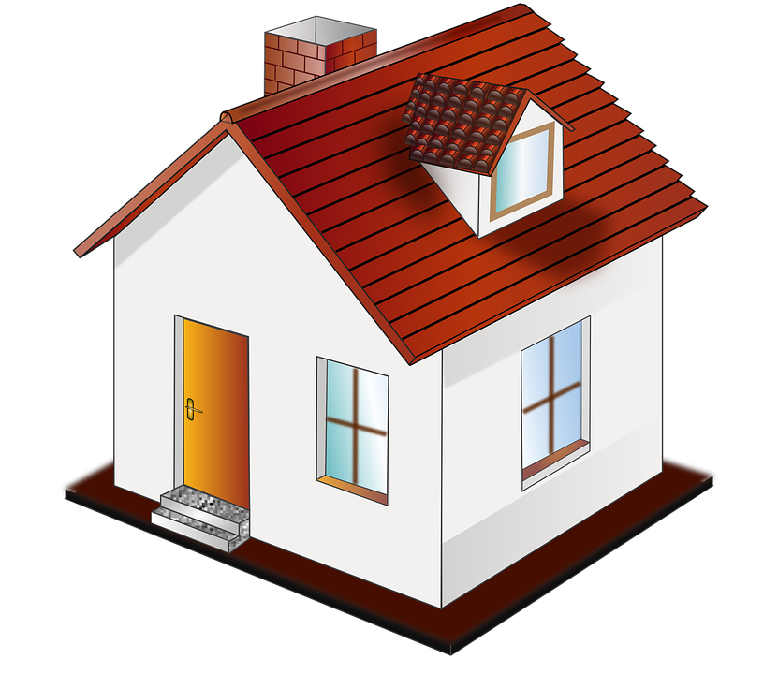
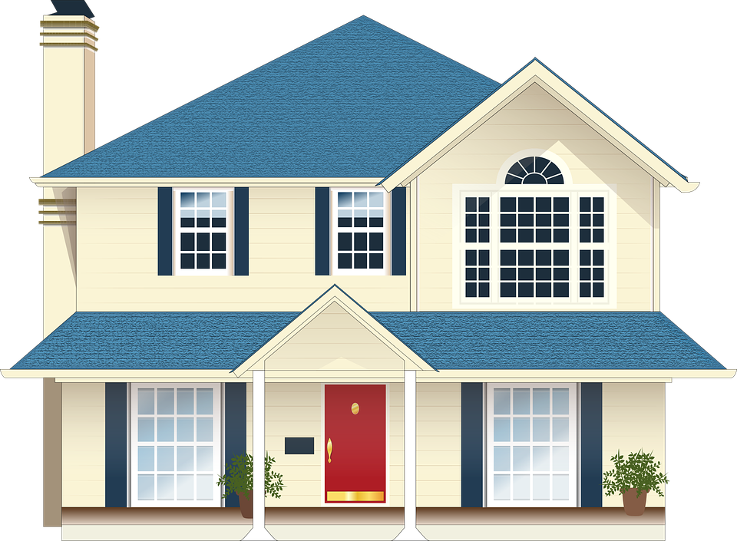










data
#D}@wu2-34
data
101
#D}@wu2-34
=

Slide 9

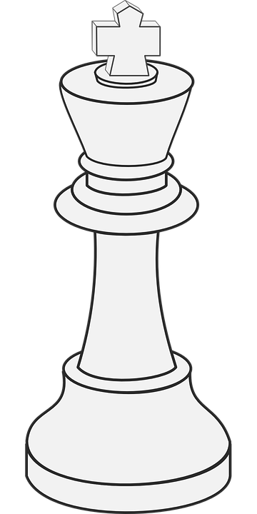
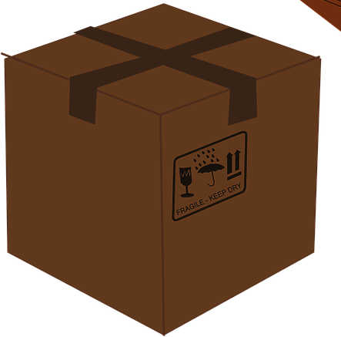
data
/&
#D}@wu2-34
data
101
#D}@wu2-34
≠

